Slide 1
Build Web Games
Chapter 7: JavaScript Array

Slide 2
HTML document structure
<!DOCTYPE html>
<html>
<head>
<title>
</title>
<style>
</style>
</head>
<body>
<div>
</div>
<script>
</script>
</body>
</html>

Slide 3
JavaScript Function definition
function Check3Blocks(id0, id1, id2) {
const text0 = document.getElementById(id0).innerText;
const text1 = document.getElementById(id1).innerText;
const text2 = document.getElementById(id2).innerText;
if (text0 !== "" && text0 === text1 && text1 === text2) {
return text0;
}
return "";
}

Slide 4
JavaScript Function Call
function checkWinner() {
// row
let letter = Check3Blocks("0_0", "1_0", "2_0");
if (letter !== "") {
return letter;
}
letter = Check3Blocks("0_1", "1_1", "2_1");
if (letter !== "") {
return letter;
}
letter = Check3Blocks("0_2", "1_2", "2_2");
if (letter !== "") {
return letter;
}
…
…
// column
letter = Check3Blocks("0_0", "0_1", "0_2");
if (letter !== "") {
return letter;
}
letter = Check3Blocks("1_0", "1_1", "1_2");
if (letter !== "") {
return letter;
}
letter = Check3Blocks("2_0", "2_1", "2_2");
if (letter !== "") {
return letter;
}
return "";
}

Slide 5
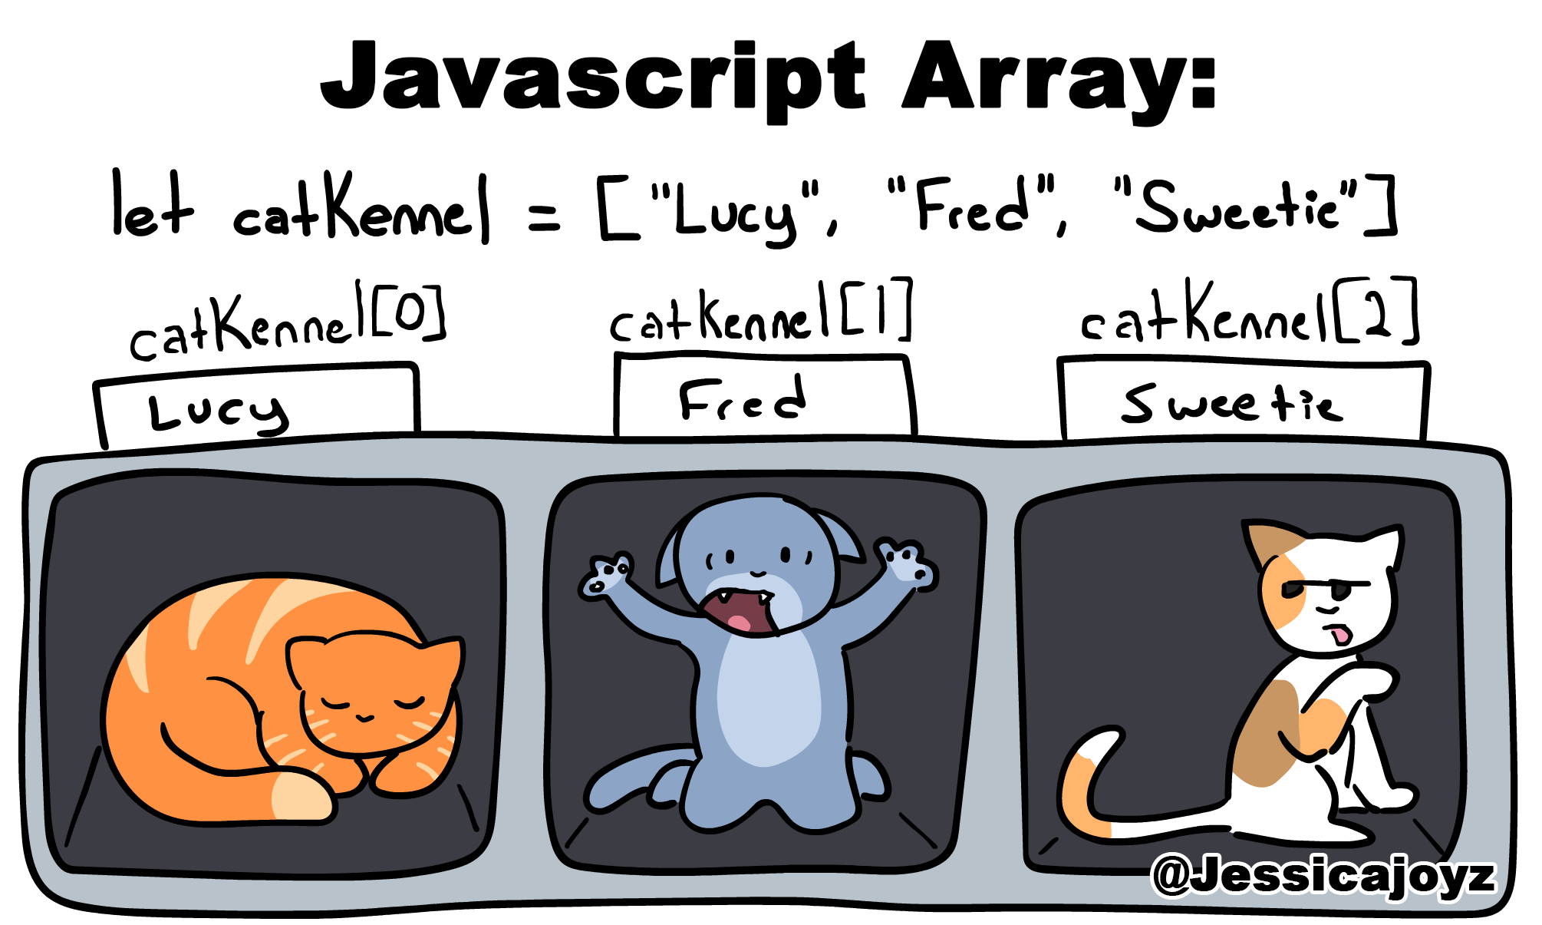
JavaScript Array
An array is like a list that can hold multiple values.
These values can be numbers, words, or anything else you want to store.

Slide 6
Create Array
let names = [“Chole”, “Arthur”, “Sophie”, “Aiden”, “Jerry”, “Marco”, “Henry”]
let fruits = ["apple", "banana", "cherry", "date"];
let numbers = [3, 2, 6, 7]
let mixed = [“apple”, 3, [2, “banana”]]

Slide 7
Access array elements
You can access individual elements in an array using their position, which is called an index.
Arrays start counting from 0. The 1st element has an index of 0, the 2nd has an index of 1, and so on.
let fruits = ["apple", "banana", "cherry", "date"];
console.log(fruits[0]); // This will display "apple" in the console.
console.log(fruits[2]); // This will display "cherry" in the console.

Slide 8
Modify array elements
You can change the values of array elements by simply assigning a new value to them using their index.
let names = ["Chole", "Arthur", "Sophie", "Aiden", "Jerry", “Marco", "Henry"];
names[2] = "Sophia";
console.log(names);
// This will now display: ["Chole", "Arthur", "Sophia", "Aiden", "Jerry", “Marco", "Henry"]

Slide 9
Add or remove array elements
You can change the values of array elements by simply assigning a new value to them using their index.
let names = ["Chole", "Arthur", "Sophie", "Aiden", "Jerry", “Marco", "Henry"];
names.push("Michael");
console.log(names); // This will now display: ["Chole", "Arthur", "Sophia", "Aiden", "Jerry", “Marco", "Henry", "Michael"]
names.pop();
console.log(names); // This will now display: ["Chole", "Arthur", "Sophia", "Aiden", "Jerry", “Marco", "Henry"]

Slide 10
Loop through an array
Arrays are often used with loops to process each element one by one.
A common loop used with arrays is the for loop:
let names = ["Chole", "Arthur", "Sophie", "Aiden", "Jerry", “Marco", "Henry"];
console.log("Number of names = ", names.length);
for(let i=0; i < names.length; ++i) {
console.log("Name[", i, "] = ", names[i]);
}
// Name[ 0 ] = Chole
// Name[ 1 ] = Arthur
// Name[ 2 ] = Sophie
// Name[ 3 ] = Aiden
// Name[ 4 ] = Jerry
// Name[ 5 ] = Marco
// Name[ 6 ] = Henry

Slide 11
Use array for id list in tic-tac-toe
const idList = [
// row
["0_0", "1_0", "2_0"]
,["0_1", "1_1", "2_1"]
,["0_2", "1_2", "2_2"]
// column
,["0_0", "0_1", "0_2"]
,["1_0", "1_1", "1_2"]
,["2_0", "2_1", "2_2"]
// cross
,["0_0", "1_1", "2_2"]
,["2_0", "1_1", "0_2"]
];
function checkWinner() {
// row
let letter = Check3Blocks("0_0", "1_0", "2_0");
if (letter !== "") {
return letter;
}
letter = Check3Blocks("0_1", "1_1", "2_1");
if (letter !== "") {
return letter;
}
letter = Check3Blocks("0_2", "1_2", "2_2");
if (letter !== "") {
return letter;
}
…

Slide 12
Loop ID array to check the winner
function checkWinner() {
const idList = [
// row
["0_0", "1_0", "2_0"]
,["0_1", "1_1", "2_1"]
,["0_2", "1_2", "2_2"]
// column
,["0_0", "0_1", "0_2"]
,["1_0", "1_1", "1_2"]
,["2_0", "2_1", "2_2"]
// cross
,["0_0", "1_1", "2_2"]
,["2_0", "1_1", "0_2"]
];
// Loop over for checking winner
for (let i = 0; i < idList.length; ++i) {
const ids = idList[i];
const winnerLetter = Check3Blocks(ids[0], ids[1], ids[2]);
if (winnerLetter !== "") {
return winnerLetter;
}
}
return "";
}

